Slide 1
TESP Overview
2/13/19

Slide 2
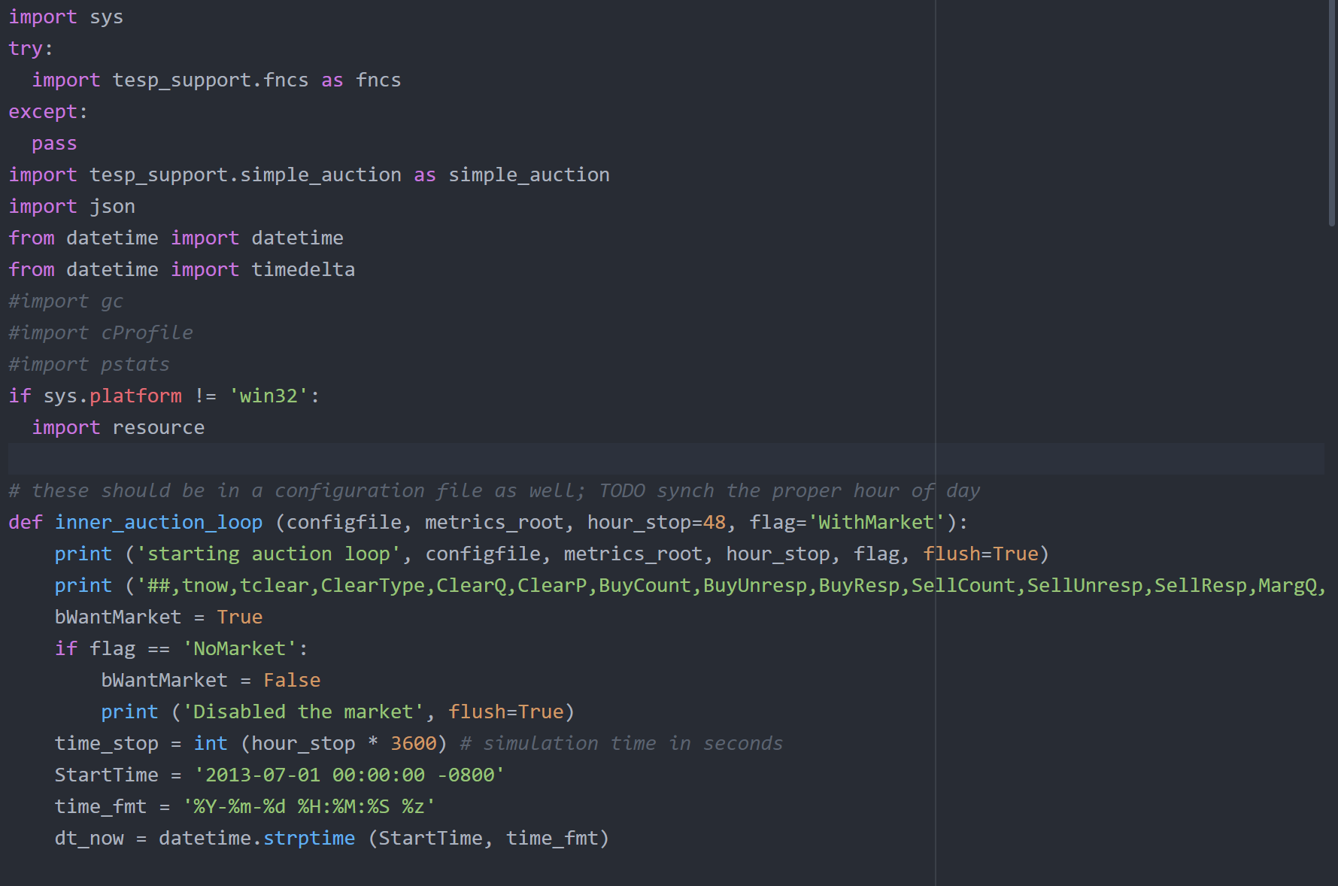
Base Learning Steps
Simulating with GridLabD
Syntax for simulation
Available inputs and outputs
Python
Basic python syntax
Importing modules
Functions
Loops
Using lists and dictionaries efficiently
Managing .json files with Python

Slide 3
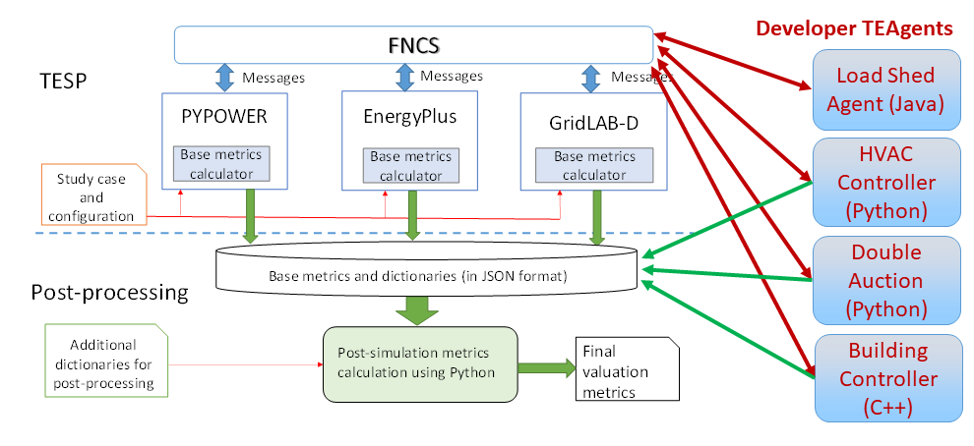
TESP - Overview
Command line simulation manager
FNCS is the time-step manager
Developers can create ‘TEAgents’ that:
Run once per time step
Interface with the simulators
Process intermediate simulator output
Control simulator inputs
https://tesp.readthedocs.io/en/latest/TESP_Overview.html

Slide 4
TESP – Details
Simulators message format:
“topic/keyword=value”
Topic: the simulator sending the message
Keyword: The part of the simulation being sent
Messages are published or subscribed
Each simulator defines its subscriptions with a .yaml file
Defines simulator name, time delta, and subscribed values
Set FNCS_CONFIG_FILE = <file_name>.yaml

Slide 5
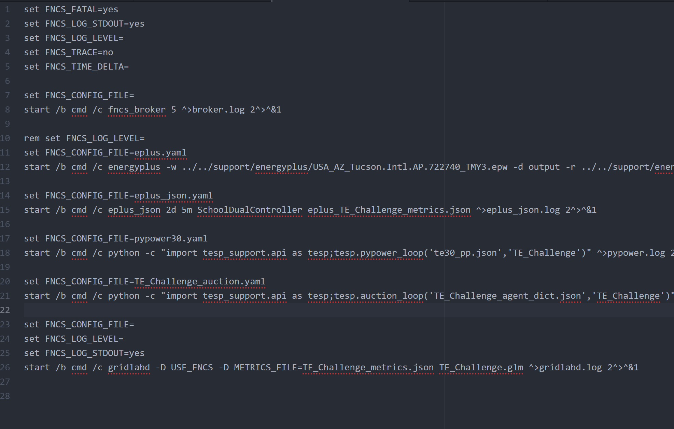
Running a Simulation
Start the FNCS Broker
For each simulator
Set FNCS config file
Start the simulator
Easiest to do in a batch script
TESP has GUI tools as well
Have not been explored yet

Slide 6
Basic TESP Workflow
Build individual simulations – design GridLabD Simulation
Define subscribed values for each simulator
Write a TEAgent to manage simulation
Run a loop for each FNCS time step
Read/Process any necessary simulator values
Write any intermediate metrics to .json files
Publish new simulator values

Slide 7
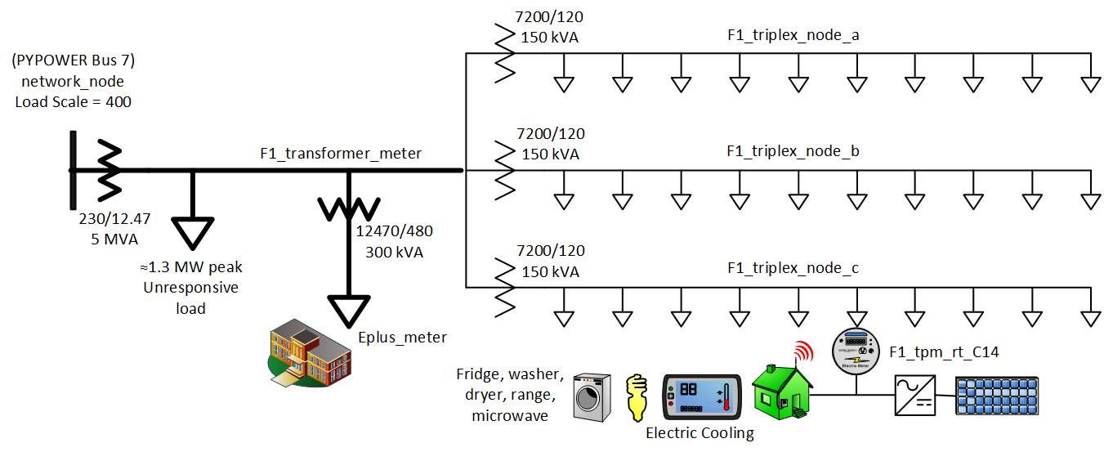
TE30 Example Simulation
30 homes with Solar power in GridLab-D
1 Large School Building in EnergyPlus
1.3 MW Invariant “Base Load”
Feeder simulated with PYPOWER
https://tesp.readthedocs.io/en/latest/SGIP1_Example.html

Slide 8
TE30 Control/TEAgent
Currently uses the simple auction agent from PNNL
Grants each house an HVAC load based on the LMP of distributed solar and distribution feeder
Additional Functionality can be added
Batteries alongside distributed solar
Switches to control inverter power flow
Either charge batteries or send to grid
Switches could be controlled by publishing from the TEAgent
Max inverter power output (if GridLabD supports)
Do not yet have a modified proof of concept
Runtime error in simulation

Slide 9
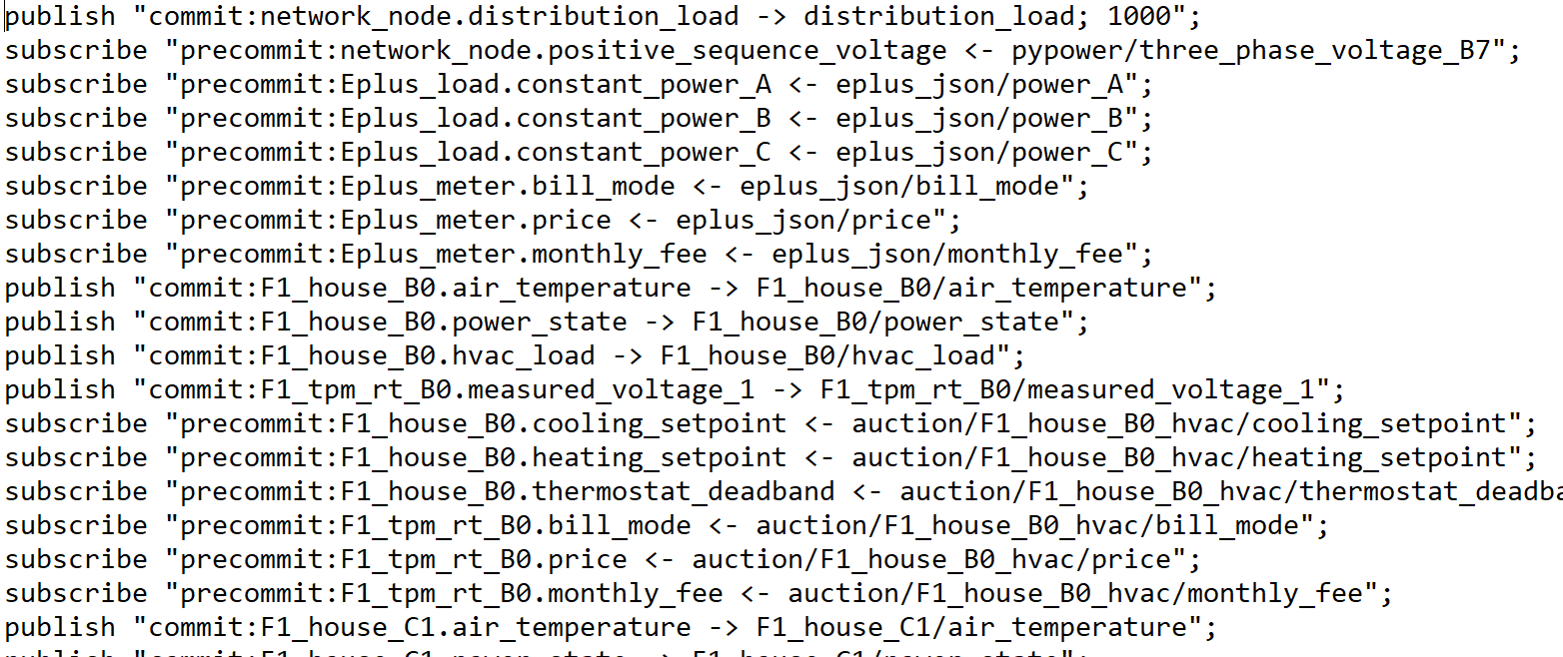
TE30 Values Available for Subscribe/Publish

Slide 10
Future Steps
1. Demonstrate TE30 proof of concept
Time Estimate: <1 week from today
2. Design a GridLabD simulation/find suitable existing example
Likely will not use PyPower or EnergyPlus in first version
TESP Support tools
Automatically generate simulations
Adequately document simulation parameters
Time Estimate: <1 week from start

Slide 11
Future Steps
3. Write a TEAgent that controls the simulation
For each time step in the simulation:
Report current simulation values to the transactive energy system
Collect and record cleared transactions from the system
Publish the cleared transactions when their timestep is reached
Time Estimate: 1-2 Weeks from start
5. Build interface for the transactive energy system to control TESP
Time Estimate: ?
6. Develop any tools needed to visualize/analyze simulation results

Slide 12
Items to Learn
Debug the example simulation, determine source of runtime error
Options available for generation/load control:
Control consumption by each house
Switches for inverter/batteries/solar
Inverter maximum power output

